Slide 1

Performance Portability Challenges for Exascale Computing
P. (Saday) Sadayappan
Ohio State University
SCEC 2018
December 13, 2018
Notes:
1

Slide 2
High-Performance Software Development Challenge
Low Performance
Very challenging to achieve high performance for GPUs and FPGAs
Requires understanding of low-level arch. details
Low Productivity
Need to program using different programming models: OpenMP for multicores, CUDA/OpenCL for GPUs, Verilog/VHDL for FPGAs
Steep learning curve: CUDA known by few; Verilog/VHDL known by fewer
Parallel programming is much more difficult than sequential C/C++
No Portability
Multiple versions of code must be maintained for different platforms
Challenges will get worse in the future: compilers must do more!
Research Direction 1: Understanding Data Movement Complexity
Research Direction 2: Domain/Pattern-Specific Transformation/Code-Gen

Slide 3
Research Direction 1: Data Movement Complexity

Slide 4
Data Movement Cost: Energy Trends
2.35x decrease
20x
85x
No Change
10x decrease
Picojoules
Source: Jim Demmel, John Shalf

Slide 5
Data Movement Cost: Performance Trends
Nvidia GPUs over 5 generations: Fermi, Maxwell, Kepler, Pascal, Volta
Peak GFLOPs and Peak Mem BW have both increased
But machine balance (Peak_GFLOPs/Peak_BW) has steadily risen => more and more constrained by data movement

Slide 6
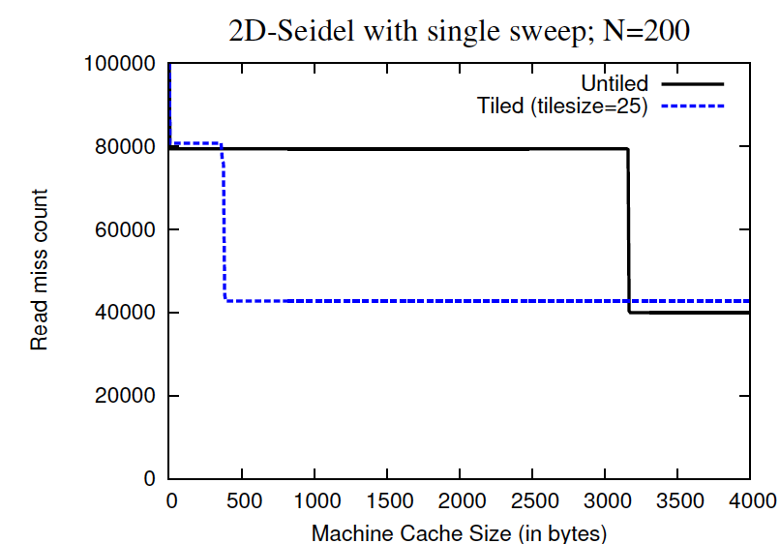
Computational vs. Data Movement Complexity
for (i=1; i<N-1; i++)
for (j=1;j<N-1; j++)
A[i][j] = A[i][j-1] + A[i-1][j];
for(it = 1; it<N−1; it +=B)
for(jt = 1; jt<N−1; jt +=B)
for(i = it; i < min(it+B, N−1); i++)
for(j = jt; j < min(jt+B, N−1); j++)
A[i][j] = A[i−1][j] + A[i][j−1];
Untiled version
Comp. complexity: (N-1)² Ops
Tiled Version
Comp. complexity: (N-1)² Ops
Data movement cost is different for two comp. equiv. versions
Also depends on cache size
Question: Can we achieve lower cache misses than this tiled version? How can we know when much further improvement is not possible?
Question: What is the lowest achievable data movement cost among all possible equivalent versions of a computation?
Current tools do not address this question

Slide 7
Modeling Data Movement Complexity: CDAG
for (i=1; i<N-1; i++)
for (j=1;j<N-1; j++)
A[i][j] = A[i][j-1] + A[i-1][j];
for(it = 1; it<N−1; it +=B)
for(jt = 1; jt<N−1; jt +=B)
for(i = it; i < min(it+B, N−1); i++)
for(j = jt; j < min(jt+B, N−1); j++)
A[i][j] = A[i−1][j] + A[i][j−1];
CDAG for N=6
Develop upper bounds on min-cost
Minimum possible data movement cost?
No known effective solution to problem
Develop lower bounds on min-cost
Hong and Kung: The Red-Blue Pebble Game, STOC 1981

Slide 8
Lower Bounds: Matrix Multiplication
Hong/Kung [STOC 1981]: Any valid implementation of the standard mat-mult algorithm on a system with cache capacity C will require Ω(N³/√C) volume of data movement between main-memory and cache
Irony et al. [JPDC 2004]: Lower bound with scaling constant:
Dongarra et al. [JFOCS 2008]: Improved constant from 1/(2√2) to 1.83
Smith, Van de Geijn; Langou: 1.83->2
Efficient tiled execution has data volume of 2N³/√C => Minimal possible data movement!
Open problem: Bounds for other algorithms
Tight data-movement lower bounds (with scaling constants) are unknown for most algorithms
for (i=0; i<N; i++)
for (j=0;j<N;j++)
for (k=0;k<N;k++)
C[i][j] += A[i][k]*B[k][j];
Processor
Cache size
C
Data movement
Main Memory

Slide 9
Example: Erroneous Roofline Limit
Recent paper contrasts achieved performance by new GPU implementations of sparse-dense matrix-multiplication (SpMM) with GPU “roofline” limits
But OI used is not a proper upper-bound for SpMM, because it is based on pessimistic reasoning about possible data reuse
Leads to incorrect conclusion that developed implementation is quite close to “best” possible
>150 GFLOPs measured on same GPU with Nvidia’s cuSPARSE SpMM
SpMM: Sparse-Dense MM
SDDMM: Sampled Dense-Dense MM

Slide 10
I/O Lower Bounds => Op. Intensity Upper Bounds
Upper-bound on operational intensity is a function of cache capacity
Mat Mult (Cache size=64Kbytes)
Mat Mult (Cache size=8 Mbytes)
FFT (Cache size=1 Gbyte)
FFT (Cache size=32Kbytes)
CG
Algorithm | #Float-Ops | I/O Lower Bound | OI Upper Bound
Matrix Multiplication | 2N³ | 16*N³/C^{1/2} bytes | (1/8)*C^{1/2} | ☺
FFT | 2*N*log₂N | 16*N*log₂N/log₂C | (1/8)*log₂C | ☹
Conj. Gradient (2D Heat Eqn.) | 20*N²*T | 48*N²*T | 5/12 | ☹
Jacobi 2D | 9*N²*T | 48*N²*T/C^{1/2} | (3/16)*C^{1/2} | ☺
Notes:
10

Slide 11
Why Optimizing Data Movement is Fundamentally Hard
Suppose FLOPs were expensive relative to data movement
Efficient functions can be simply composed, because computational complexity is additive
Let fopt₁ and fopt₂ be efficient implementations of functions f₁ and f₂
An efficient implementation for (f₁ o f₂) can be simply constructed by composing the individual implementations: (fopt₁ o fopt₂) [concatenate CDAGs]
Parallelization across multiple cores
If FLOP costs dominate data movement costs, main parallelization issue is load-balancing of work across cores
If fopt₁ and fopt₂ are each individually load-balanced, so will (fopt₁ o fopt₂₎
But what about the current reality: FLOPs are cheap, but data movement is expensive?
Problem: Data movement complexity is NOT additive under composition

Slide 12
Composing Operations: Computation vs. Data Movement
Computational complexity is additive when composing operations
S1: r1 = f1(a1,..an);
S2: r2 = f2(r1,b1,…bm);
comp-cost(S1;S2) = comp-cost(S1)+comp-cost(S2)
But data-movement complexity is not additive with composition
min-data-mvmt(S1;S2) can be less than min-data-mvmt(S1)+min-data-mvmt(S2)
Operation | Composition | Comp-Cost | Minimum Data-Mvmt
Dot-Product | N scalar mult-adds | O(N) | O(N)
Matrix-Vector Product | N Dot-Products | O(N²) | O(N²)
Matrix-Matrix Product | N Mat-Vec Products | O(N³) | O(N³/√C )

Slide 13
Lower Bounds Analysis: When is Fusion Useful?
In1
In1
Lower Bounds can be composed
Op1
IO_{LB}(Op12) = IO_{LB}(Op1) + IO_{LB}(Op2) – 2 |Out1|
Out1
Fuse?
Op12
Max I/O reduction from fusion is twice size of Out1
In2
Op2
Fusion cannot be useful when:
Out2
Out2
IO_{LB}(Op1) + IO_{LB} (Op2) is much larger than |Out1|
Lower bounds analysis can help prune many configs.

Slide 14
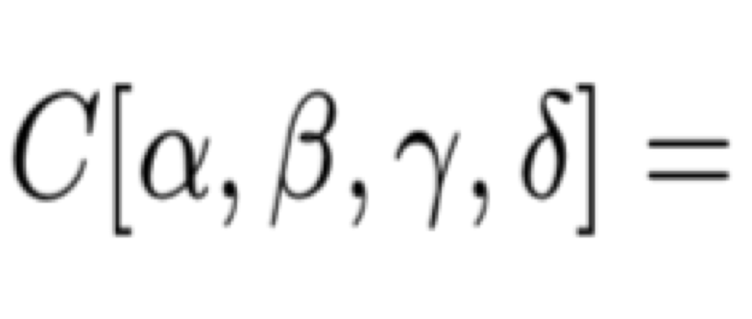
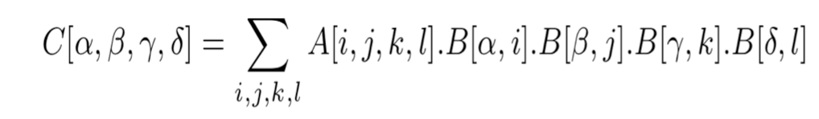
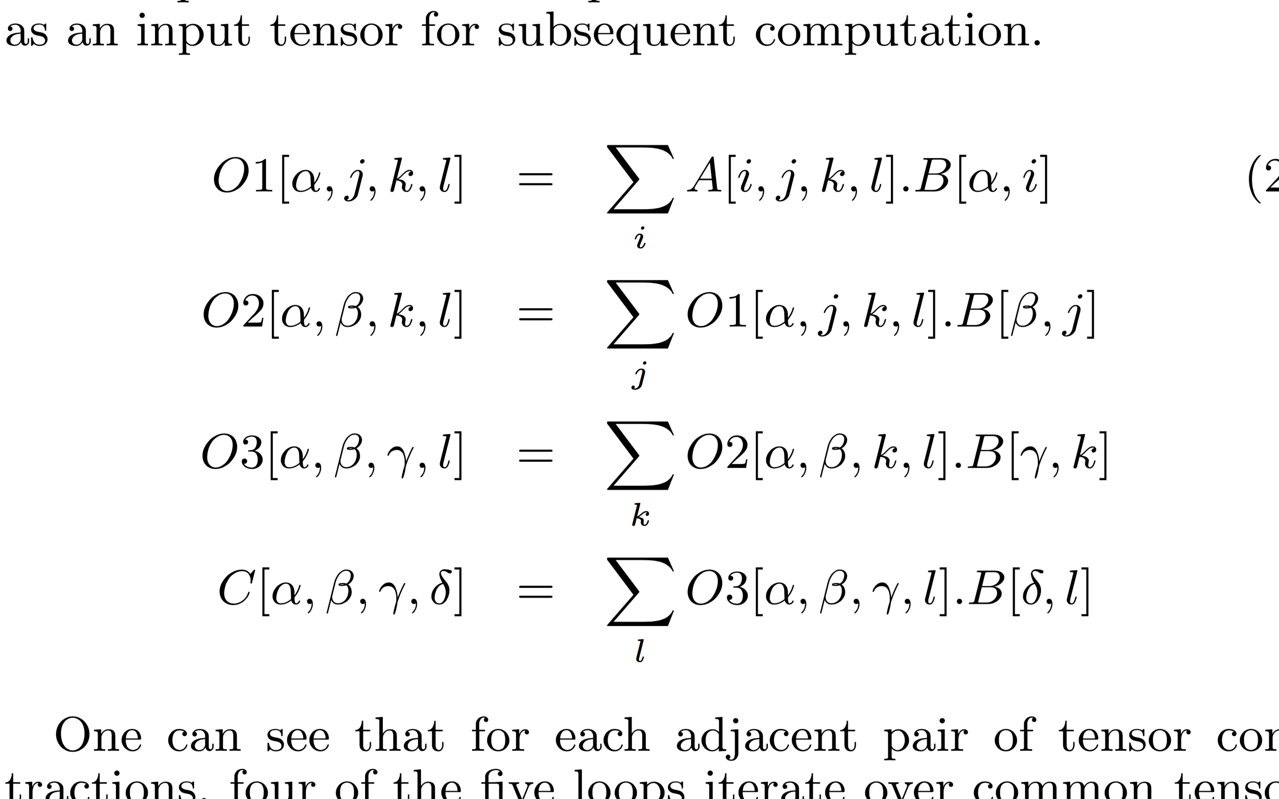

Optimizing the Four-Index Integral Transform
4-D integral tensor (A) transformed from one basis to another (C) using transformer B
Implemented as sequence of four tensor contractions
Combinatorially explosive number of fusion/tiling/distribution choices
NWChem comp. chem. suite implements 15 different variants of 4-index transform; none optimal
New “communication-optimal” distributed 4-index transform developed by OSU/PNNL collaboration
Space of configs. pruned by data mvmt. lower bounds analysis
Significant improvement over previous NWChem versions
Incorporated into NWChem

Slide 15
Open Questions
Can tools be developed to automatically characterize data movement complexity of algorithms?
Can a general methodology be developed for use of data-movement lower-bounds in guiding design-space exploration?
Can data-movement lower-bounds be used for algorithm-architecture co-design?
Example: Are 16 registers too few for efficient implementation of a CNN (Convolutional Neural Network) kernel?
Can data movement constraints of irregular/sparse applications be characterized and used for optimization?

Slide 16
Research Direction: Pattern-Specific Optimization

Slide 17
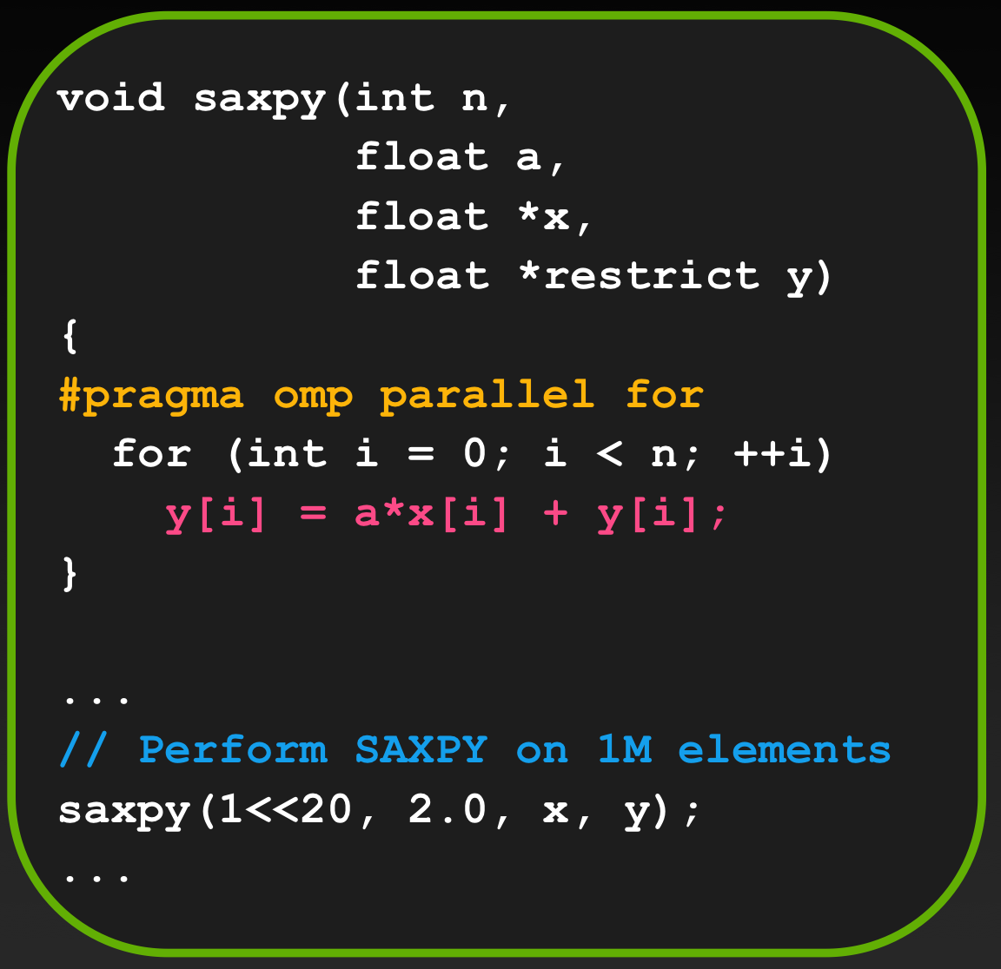
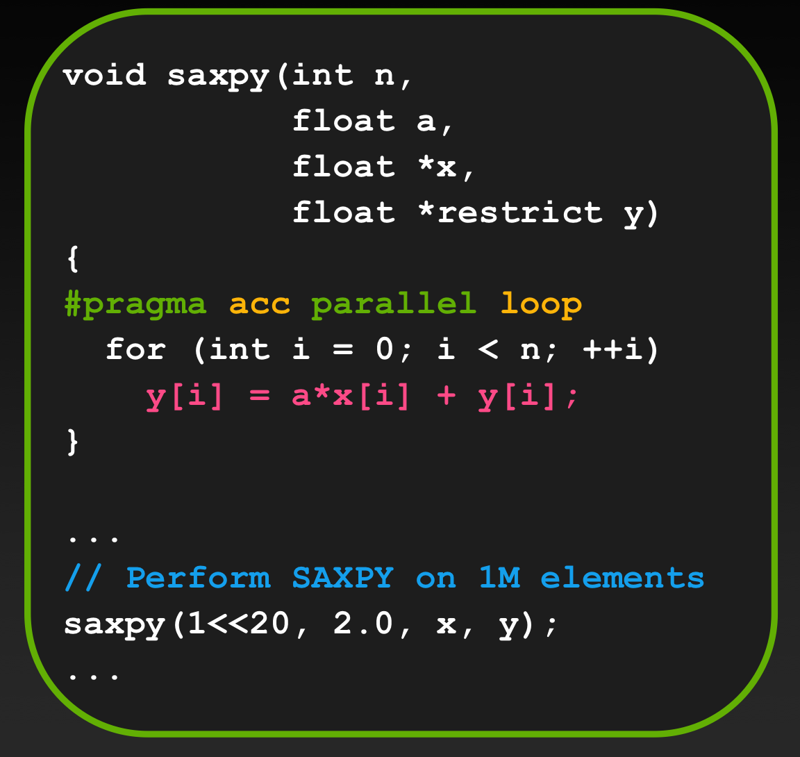
Portability: OpenACC and OpenMP-Offload
Directive-based prog. models for GPU/Accelerator offload
Spec. of computation in source code very similar to sequential code
Directives specify parts of code to be offloaded to GPU
User can optionally control when data is moved between CPU/GPU
OpenMP
OpenACC
Source: Jeff Larkin

Slide 18
Case Study: OpenACC and OpenMP
Directive based optimization of radiation scheme ACRANEB2 in Danish weather prediction model: KNL, Pascal GPU, Xeon
Poulsen and Berg, http://www.dmi.dk/fileadmin/user_upload/Rapporter/TR2017/SR17-22.pdf
Conclusion: Even with directive-based models, achieving high performance requires different source-code versions
Loops had to be rearranged and data-structure layouts changed
Performance difference for variants can be huge
X: Code version tuned for KNL
G: Code tuned GPU with same data structures
GNM: GPU-tuned, with transposed data structures
Good perf. boost on GPU, but about 100x slowdown for KNL!

Slide 19
Performance: Stencil DSL vs. General-Purpose
DSL-generated GPU code achieves much higher performance
Notes:
19

Slide 20
Domain-Specific Optimization: Tensor Contractions
for (i=0; i<N; i++)
for (j=0; j<N; j++)
for (k=0; k<N; k++)
for (l=0; l<N; l++)
for (m=0; m<N; m++)
for (n=0; n<N; n++)
C[i][j][k][l] += A[i][m][k][n]*B[j][n][l][m];
Tensor contraction is high-dimension analog of matrix-matrix product
Each loop index appears in exactly two tensors
“Contraction index” appears only in input (rhs) tensors: {m, n}
“External index”: appears in output tensor and one input tensor: {i, k} {j, l}
TensorGen project (OSU/PNNL) is developing domain-specific compiler for multi-target (GPU, multi/manycore CPU) optimization of arbitrary tensor contractions
Specialized schema for optimized data movement/buffering

Slide 21
Matrix Multiplication Schema
C[i][j] += A[i][k]*B[k][j]
A 2D thread-block computes a 2D slice (TixTj) of C using a Ti x Nk slice of A and a Nk x Tj slice of B
Registers are used to hold the TixTj slice of C
A TixTk slice of A and a TkxTj slice of B are loaded into Shared Memory (1)
GMEM
N_{j}
B
(1)
⌈N_{k}/T_{k}⌉
N_{k}
T_{j}
T_{k}
(1)
SMEM
⌈N_{k}/T_{k}⌉
T_{j}
N_{i}
N_{i}
T_{i}
T_{i}
A
N_{k}
T_{k}
N_{j}
C
GMEM
SMEM
GMEM
Notes:
Now, Let’s look at the steps involved in executing a matrix multiplication in a thread block based on our mapping strategy. //
First of all, a thread block computes a slice of the output C such as T_i times T_j. //
Then, it requires these two slices of input A and B.//
However, due to the limited size of shared memory, we also use a tile-size of the internal index k. //
So, per each step, we load some portions from two slices of A and B from Shared Memory. //

Slide 22
Matrix Multiplication Schema
C[i][j] += A[i][k]*B[k][j]
A TixTk slice of A and a TkxTj slice of B are loaded into Shared Memory (1)
A column-slice of A and row-slice of B are loaded from shared memory to registers (2)
Outer-product contribution added to slice of C (3)
Slice of C is written out to global memory (4)
GMEM
N_{j}
B
(1)
N_{k}
⌈N_{k}/T_{k}⌉
T_{j}
T_{k}
(1)
SMEM
⌈N_{k}/T_{k}⌉
(3) Outer-Product
T_{j}
(2)
N_{i}
N_{i}
T_{j}
T_{i}
(2)
T_{i}
⊗
A
N_{k}
T_{k}
T_{i}
N_{j}
C
(4)
GMEM
SMEM
REG
GMEM
Notes:
After we load slices of input tensors on Shared Memory, /
thread block will load a column-vector of A / and a row-vector of B from SMEM to Registers. //
Then, the thread block computes an outer-product contribution to the output slice. //
This repeats Tk times.
Finally, after N_k by T_k steps, / the thread block stores the output tensor slice to Global Memory. //

Slide 23
Generalizing for Arbitrary Tensor Contractions
Custom optimizer exploits “orthogonal reuse directions” property
t2 reuse: {b,c,k}; v2 reuse: {a,i,j}; t3 reuse: {d} (reduction)
2D multi-level tiling (shared-memory + registers); streamed tiling along {d}
Slice of t3 held in register tiles; maximize reuse of data slices of t2 and v2

Slide 24
CCSD(T) Tensor Contractions in NWChem
CCSD(T) is an accurate but extremely compute-intensive method in NWChem
New fused GPU kernels significantly outperform current GPU code in NWChem
Code is being incorporated into NWChenEX

Slide 25
Isolated Domain-Specific Compilers and Libraries
Multi-target DSLs achieve performance & portability by:
Use of appropriate internal representation of computation that facilitates effective choice of mapping/scheduling of computation/data
Separation of high-level target-independent decisions from low-level platform-specific choices
Use of platform-specific code-schema driven by key performance factors
But each Domain-Specific compiler/library today is a stand-alone system
No common infrastructure support for building new DSLs
DSL₁
DSL₂
DSL_{m}
AVX
PTX
…
CUDA
VHDL

Slide 26
Intermediate Pattern-Specific Layers?
Can a small number of Pattern-Specific IRs be identified?
DSLs perform domain-specific transformations and generate suitable PSIR
Pattern-Specific Compiler performs platform-specific optimizations/transformations for different target platforms
DSL₁
DSL₂
…
DSL_{m}
PSIR₁
…
PSIR_{k}
AVX
PTX
…
CUDA
VHDL

Slide 27
Matrices/Tensors: Orthogonal Aligned Reuse Pattern
Many matrix/tensor computations in computational science and data-science/ML have the following characteristics
Access functions for matrix/tensor indices are simply surrounding loop indices
C[i][j] += A[i][k]*B[k][j]
A[i][r] += T[i][j][k]*B[j][r]*C[k][r]
Reuse of data elements occurs only along iteration space axes (1D) or product-space of axes (2D and higher reuse)
All surrounding loops represent reuse directions for one or more arrays
Optimal tile size for innermost tiling loop is always one (or vector-length if that loop is innermost intra-tile loop) => streaming
Permutation of outer tiling loops have negligible effect on data mvmt. vol.
Significant promise for efficient data-volume based model-driven loop transformation and multi-target code generation for this class of computations

Slide 28
Summary
End of Moore’s Law implies greater customization and need to make more efficient use of limited resources
Achieving performance, productivity, and portability will be even more challenging => Compilers must play a bigger role
Fundamental bottleneck: data movement (FLOPs are relatively cheap)
Need advances in understading inherent data movement complexity of algorithms
Domain/pattern-specific compiler optimization is a promising direction
Need to identify a small number of computational patterns with wide coverage, and pattern-specific compiler transformation strategies for the patterns
Many challenges and opportunities: exciting time to work on compiler research!

Slide 29
Acknowledgment
Many thanks to many collaborators, especially Sriram Krishnamoorthy, Louis-Noel Pouchet, Nasko Rountev, Uday Bondhugula, Albert Cohen, Jason Cong, Franz Franchetti, John Owens, Srini Parthasarathy, Dan Quinlan, J. Ramanujam, Fabrice Rastello, Vivek Sarkar, …; and numerous current and former graduate students and post-docs including Venmugil Elango, Tom Henretty, Justin Holewinski, Changwan Hong, Jinsung Kim, Martin Kong, Rakshith Kunchum, Emre Kurt, Israt Nisa, Samyam Rajbhandari, Mahesh Ravishankar, Prashant Rawat, Aravind Sukumaran-Rajam, Kevin Stock, ...
Grateful thanks for funding from the U.S. National Science Foundation, U.S. Department of Energy, and DARPA

